Slide 1

LECTURE 9:
TOEIC TEST WRITING
Questions 6-7: Respond to a Written Request

Slide 2
Structuring response to a written request
Greeting
- Greet the person the e-mail is directed to
Opening Statement
- First sentence of your response
- Explain the purpose of your email
- Introduce yourself if necessary
Supporting information 1
- Address the first task as specified by the directions.
* Supporting information 2
- Address the second task as specified by the directions.
* Supporting information 3
- Address the third task as specified by the directions.
* Concluding Statement and Request for Action
- Conclude the email.
- Explain any further action that may be needed.
* Closing
- Sign the e-mail as the role indicates

Slide 3
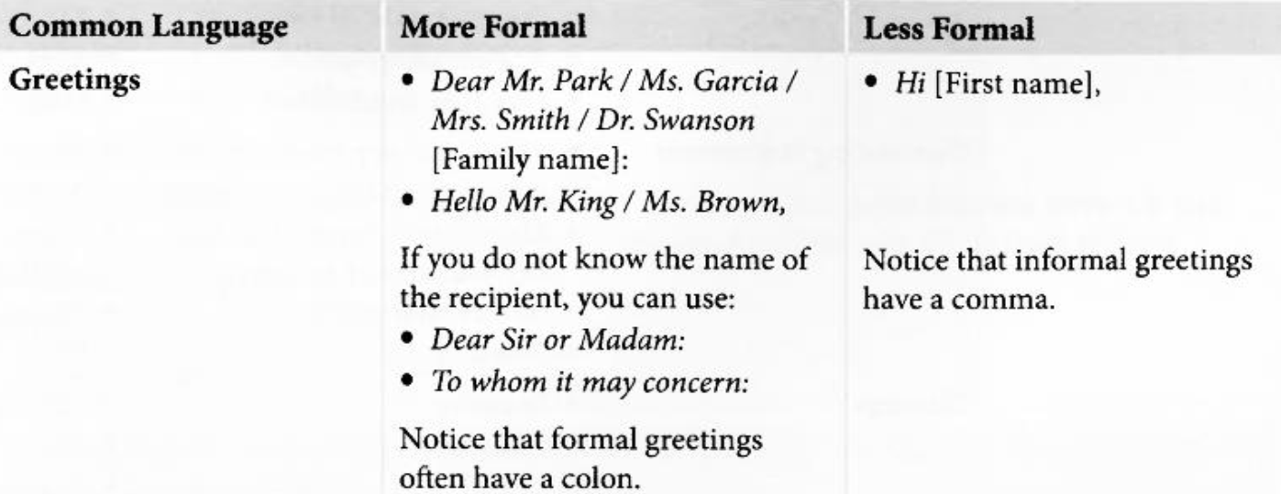
Suggested common language used to respond

Slide 4
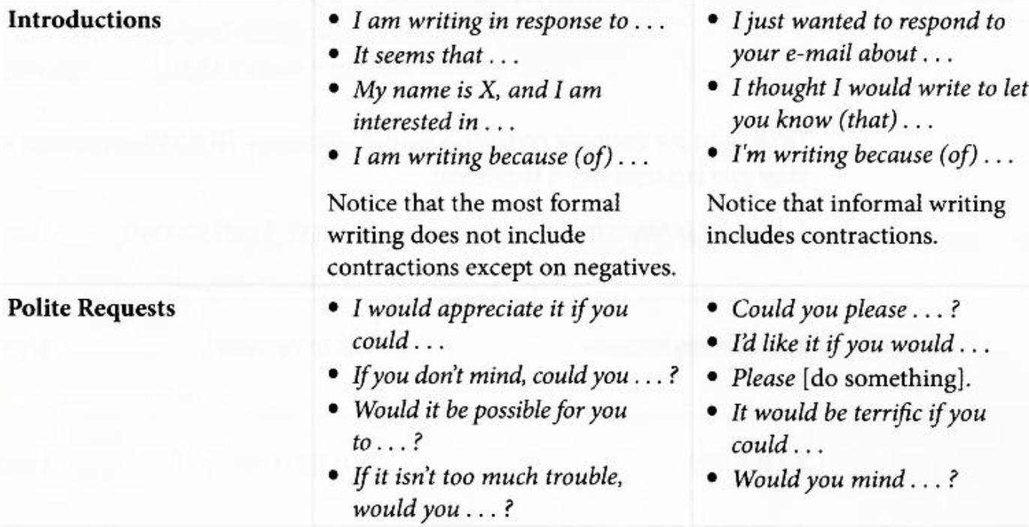

Slide 5
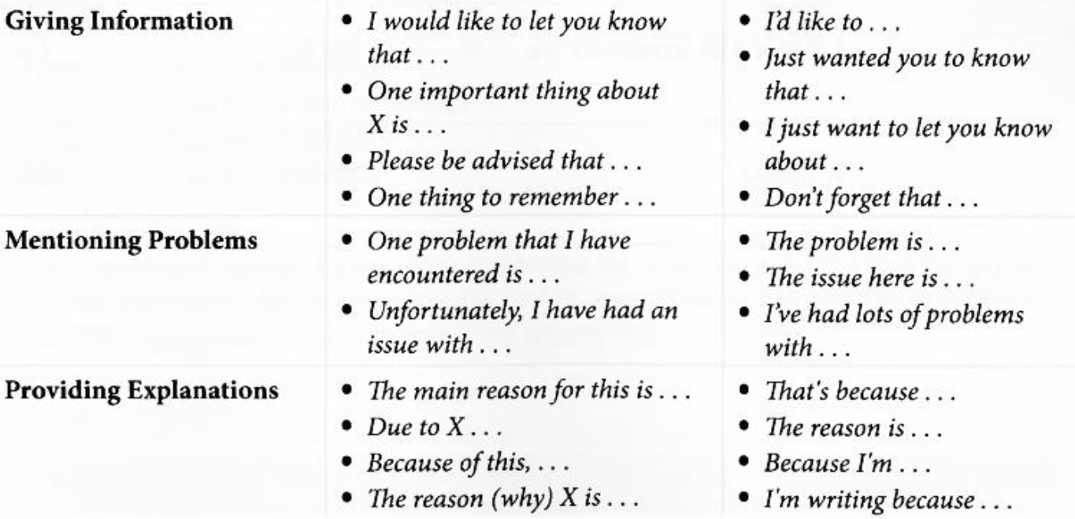

Slide 6
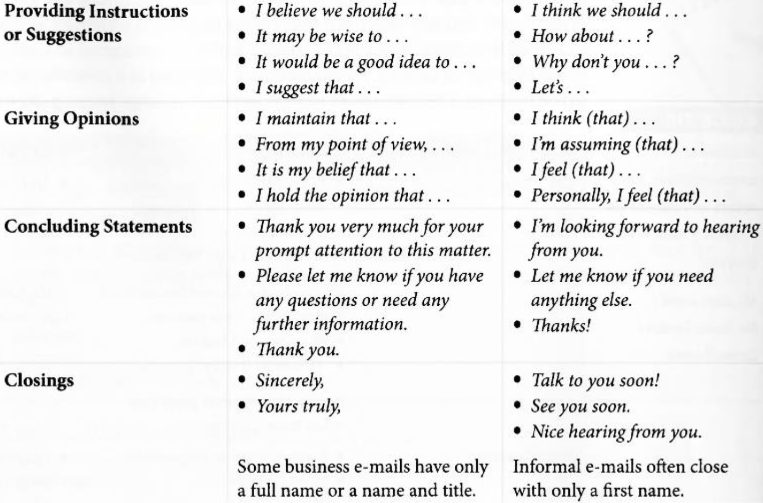

Slide 7
TASK SAMPLE 1

Slide 8
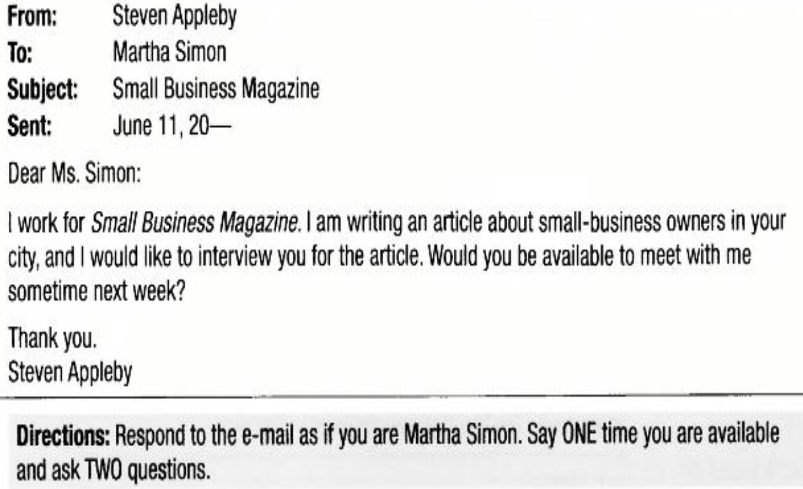

Slide 9
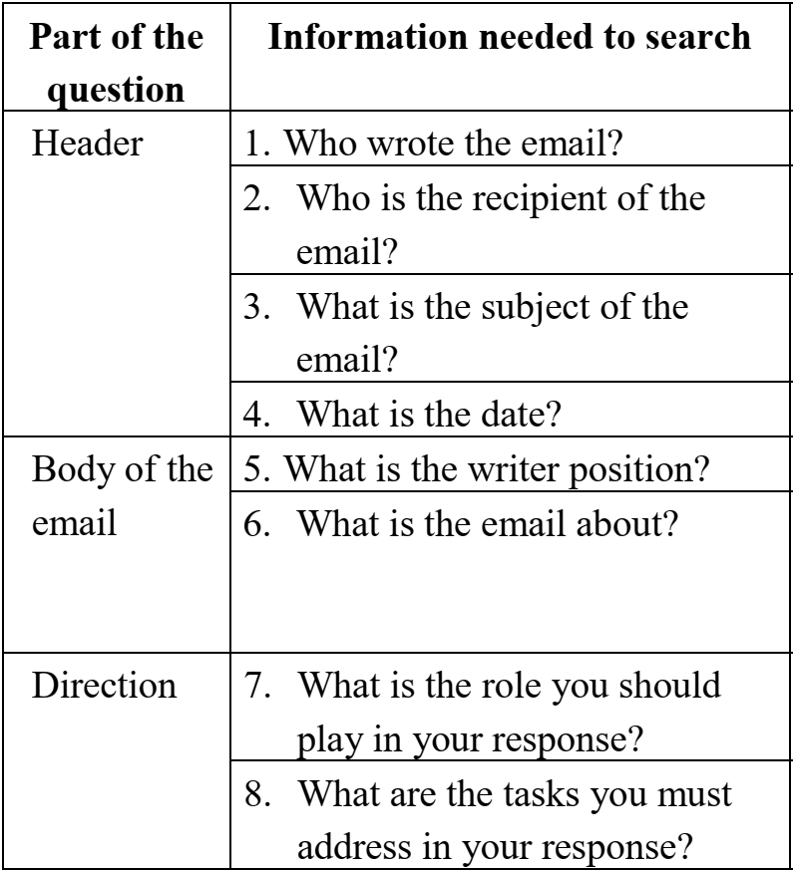

Sample analysis of the sample question
Steven Appleby
Martha Simon
Small business Magazine
June 11, 20
I work for Small Business Magazine
A request for an Interview (I would like to interview you for the article)
Respond to the email as if you are Martha Simon
Say ONE time you are available and ask TWO questions

Slide 10
Sample Answer
1. Greeting
2. Opening statement
3. Supporting information 1
4. Supporting information 2
5. Concluding statement
6. Closing
(1) Dear Mr. Appleby,
(2) I will be very happy to let you interview me for your article. (3) I will be free next Tuesday afternoon at
2:00. I hope that is a good time for you. (4) I have a
couple of questions. How long do you think the
interview will last? Also, could you tell me exactly
what the subject of your article is? (5) I’m looking
forward to meeting you.
(6) Yours sincerely,
Martha Simon

Slide 11
TASK SAMPLE 2

Slide 12
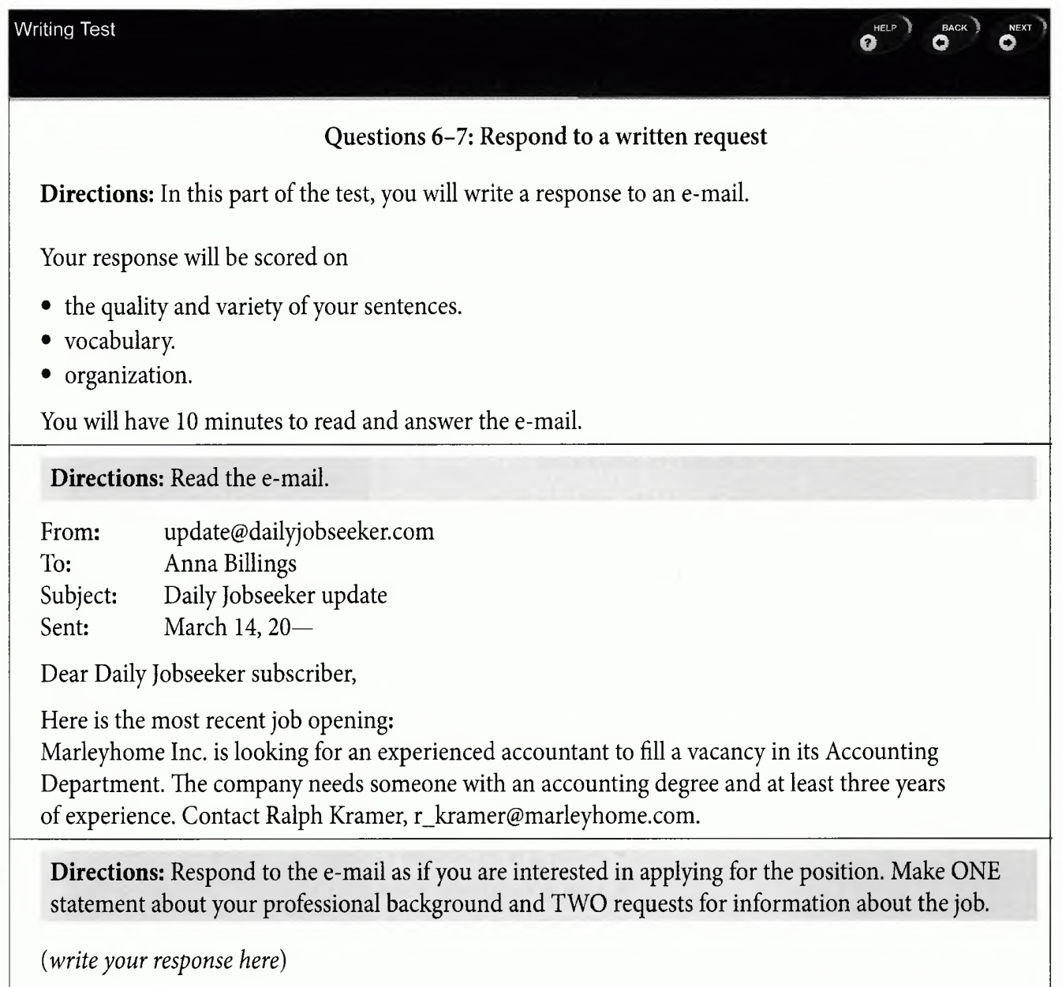

Slide 13
PROGRESSIVE PRACTICE

Slide 14
CONSOLIDATION
https://www.baamboozle.com/game/176999

Slide 15
HOMEWORK
Progressive practice (p. 125, 126)

